Slide 1
Ydych chi’n gêm?
v
Gemau y gallwch chwarae yn y ty neu yn yr ardd.
Translation of all activities included

Slide 2
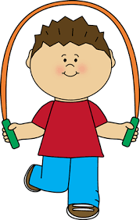
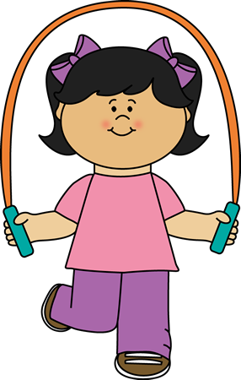
Rhigwm Sgipio 1.
Rhigwm i’w dweud wrth sgipio.
Rydw i eisiau coffi.
Rwyt ti eisiau te.
Mae o a hi eisiau cacen i de.
Rydyn ni eisiau oren.
Rydych chi eisiau llaeth.
Maen nhw eisiau diod o ysgytlaeth.
Translation of skipping rhyme
I want coffee.
You(singular) want tea.
He and she wants a cake for tea.
We want orange.
You(plural) want milk.
They want a drink of milkshake.

Slide 3
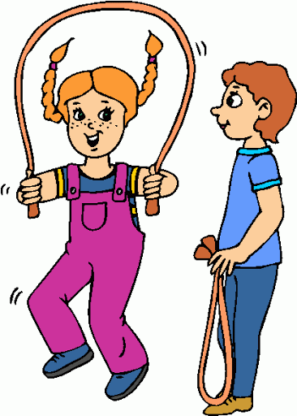
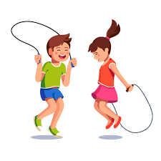
Rhigwm Sgipio 2.
Rhigwm i’w dweud wrth sgipio.
Rwyt ti yn cyfrif un, dau,tri.
Maen nhw yn canu do, re, mi.
Mae o a hi a Mot y ci.
Yn sgipio’n hapus efo fi.
Translation of skipping rhyme
You(singular) are counting one,two,three .
They are singing do,re,mi.
He and she and Mot the dog.
Are skipping happily with me.

Slide 4
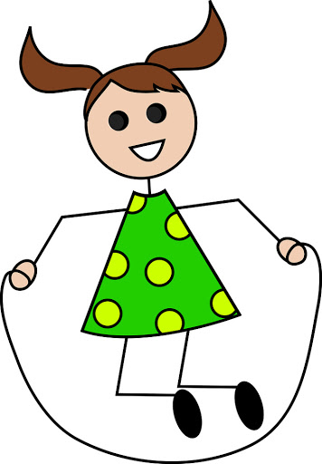
Rhigwm Sgipio 3.
Rhigwm i’w dweud wrth sgipio.
Mae gen i gi, ei enw yw Twm.
Mae’n ffrind bach da i mi.
Oes gennych chi gi bach fel Twm.
Sy’n ffrind bach da i chi.
Translation of skipping rhyme
I’ve got a dog, his name is Twm .
He’s a good little friend to me.
Have you got a little dog like Twm.
Who’s a good friend to you.

Slide 5
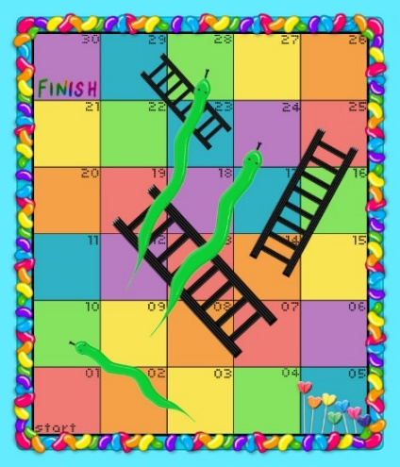
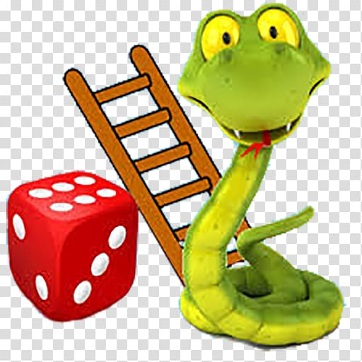
Lawr y neidr a fyny’r ysgol
Snakes and Ladders
Dewch i chwarae!
Pa liw cownteri wyt ti eisiau?
Coch, glas, melyn neu gwyrdd?
Rhowch y cownteri yn y dechrau.
Pwy sy’n mynd gyntaf.
Taflwch y dîs os gwelwch yn dda.
Pwy sydd wedi cael y rhif uchaf?
Fi!
Ti sy’n mynd gyntaf, felly.
Da iawn ti. Rwyt ti wedi cael . . .
O diar rwyt ti wedi cael . . .
Dy dro di/Fy nhro i.
O na rydw i wedi glanio ar y neidr.
Rydw i’n mynd lawr.
O gwych rydw i wedi cael ysgol
Rydw i’n mynd i fyny.
Hwre! Rydw i wedi gorffen yn gyntaf.
Da iawn ti.
Translation
What colour counters do you want?
Red, blue, yellow, green?
Put your counters at the start.
Who is going to go first?
Throw the dice please.
Who had the highest number.?
Me!
You go first, then.
Very good. You’ve had . . .
Your turn/My turn.
Oh no, I’ve landed on a snake.
I’m going down.
Oh, brilliant, I’ve landed on a ladder
I’m going up.
Hooray. I finished first.
Very good
Pwy sydd eisiau
chwarae’r gêm?
Who wants to play the game?
Un
Dau
Tri
Pedwar
Pump
Chwech

Slide 6
Pwy ydy Pwy?
Guess Who?
Translation
Have you got . . . ?
Has he got . . . ?
Has she got . . . ?
Yes/No
Yes he has/Yes, she has
No he hasn’t
No she hasn’t
blonde hair/brown/white/black/red/
bald head
round face/long/small/big/narrow
small ears/big/long
small mouth/big/thin
spectacles or glasses
beard
moustache
hat
ribbon
Oes gen ti . . . ?
Oes ganddo fo . . .?
Oes ganddi hi . . .?
Oes/Nagoes
Oes mae ganddo fo/Oes mae ganddi hi
Nagoes does ganddo fo ddim
Nagoes does ganddi hi ddim
wallt melyn/brown/gwyn/du/coch/
ben moel
lygaid glas/gwyrdd/brown/hir/byr/cyrliog
wyneb crwn/hir/bach/mawr/main
glustiau bach/mawr/hir
geg fach/fawr/denau
sbectol
farf
fwstas
het
ruban
Translation
You will notice the mutations as you use these words with the language patterns used here.
gwallt – hair
pen – head
llygaid – eyes
clustiau – ears
ceg – mouth
barf – beard
mwstas – moustache
Sometimes you will see
(g)wyneb - face
Pwy sydd eisiau
chwarae’r gêm?
Who wants to play the game?

Slide 7
Fedri di sgorio goliau?
Translation
You will need:-
A goal or two cones to create a goal
A football
A cone as a shooting point.
Remember to keep them tidy when finished.
Byddwch angen:-
Gôl neu dau gôn i wneud gôl
Pêl
Côn fel pwynt saethu
Cofiwch eu cadw yn daclus wedyn.
Dyma eich tasg
Gosodwch y gôl a dewisiwch bwynt saethu gan osod y côn.
Saethwch at y gôl o’r pwynt yma.
Symudwch y conau i wahanol lefydd pell ac agos o’r gôl.
Gwnewch hyn dro ar ôl tro nes byddwch wedi sgorio 10.
Pa mor llwyddiannus oeddech chi?
Translation
Here is your task
Put the goal in place and choose a shooting point by placing the cone.
Shoot towards the goal from this point.
Move the cone to different positions near and far from the goal.
Carry on until you have scored 10 goals.
How successful were you?

Slide 8
Mae rhaglen “Heno” ar S4C yn gofyn i chi yrru clipiau ohonoch yn sgorio goliau yn yr ardd gefn iddynt ddangos ar eu rhaglen.
Os nad ydych eisiau gyrru clip gallwch ymarfer y sgil.
heno@tinopolis.com.
Translation
The “Heno” programme on S4C is asking you to send in video clips of the goals that you score in your garden for them to show on the programme.
If you do not wish to send in a clip you can always just practice the skill.
heno@tinopolis.com.
Pwyntiau Ymarfer
Ewch am y bêl o dipyn o ongl.
Cadwch y droed arall yn agos i’r bêl.
Gwyrwch eich pen dros y bêl
Lledwch eich breichiau i gael eich “balans”.
Ciciwch bêl yn ei chanol i gyfeiriad y gôl.
Translation of Practice points
Approach ball from slight angle.
Keep other foot close to the ball
Keep your head down and over the ball
Place arms out to your side to gain balance.
Strike through centre of ball towards goal.

Slide 9
Golgeidwad gorau erioed
Pwyntiau Ymarfer
Ewch i’r llinell yn gyflym.
Daliwch y bêl mor aml â phosib.
Codwch eich dwylo uwch eich pen gan wneud siâp “W”
Cadwch y bêl wrth y frest
Cadwch eich llygaid ar y bêl
Translation of Practice points
Get quickly into line.
Catch the ball as often as possible
Lift your hands up and make “W” shape in the air.
Keep ball by the chest
Keep your eye on the ball.
Sawl gôl ydych chi wedi ei dal heddiw?
Cadwch sgor eraill yn y ty.
Pwy ydy’r golgeidwad gorau erioed?
v
Translation
How many goals have you scored?
Keep the household scores
Who is the best ever goalie?

Slide 10
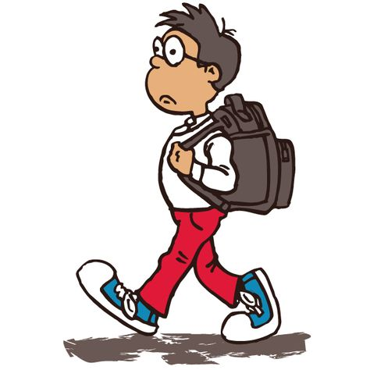
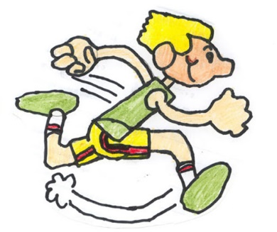
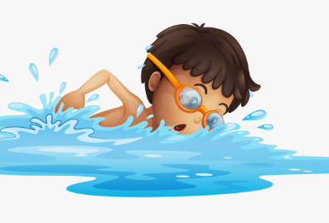
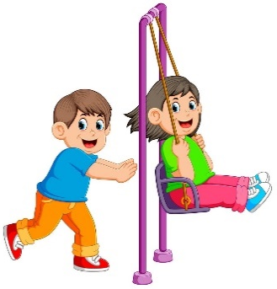
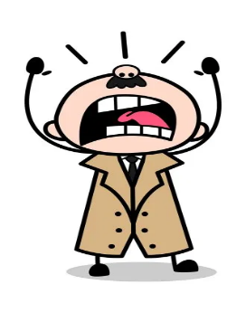
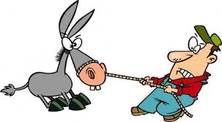
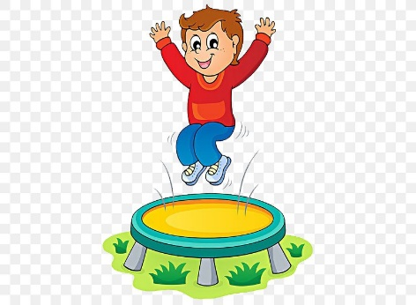
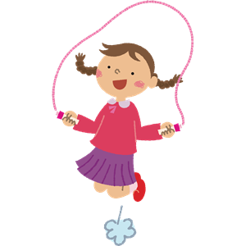
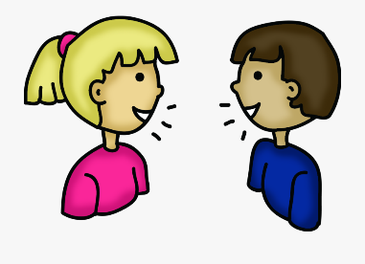
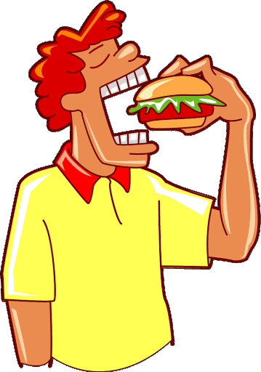
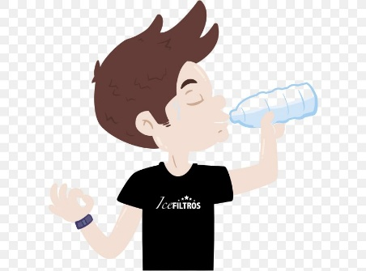
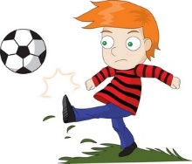
cerdded
rhedeg
dawnsio
nofio
codi
gwthio
tynnu
gweiddi
chwerthin
neidio
sgipio
siarad
cicio
bwyta
yfed
pwyntio

Slide 11
Mae un yn dewis berf o’r grid ac yn ei ysgrifennu ar bapur.
(gair sy’n dangos beth mae rhywun yn ei wneud yw berf)
Bydd y gweddill yn ceisio dyfalu pa ferf sydd ganddo gan ofyn beth mae’n wneud fel hyn:-
Wyt ti’n . . . ?
Mae’r llall yn ateb fel hyn:-
Ydw, rydw i’n . . .
neu
Nag ydw dydw i ddim yn . . .
Os oes tîm o ddau wedi dewis berf gallant ofyn:-
Ydych chi’n . . .
Mae’r lleill yn ateb fel hyn:-
Ydyn rydyn ni’n . . .
Nag ydyn dydyn ni ddim yn . . .
Bydd y gêm yn parhau nes fod y ferf gywir wedi ei darganfod. Gallwch ei chwarae drosodd a throsodd.

Slide 12
cerdded
walking
rhedeg
running
dawnsio
dancing
nofio
swimming
codi
lifting
gwthio
pushing
gweiddi
shouting
tynnu
pulling
siarad
talking
chwerthin
laughing
neidio
jumping
sgipio
skipping
cicio
kicking
bwyta
eating
yfed
drinking
pwyntio
pointing

Slide 13
Translation
One person to choose a verb from the grid and write it down on a piece of paper.
(a verb is a doing word it tells us what somebody is doing)
The others guess which verb he/she has chosen and is doing by asking :-
Wyt ti’n . . . ? Are you . . .?
The other answers:-
Ydw, rydw i’n . . . /Yes I am . . .
or
Nag ydw dydw i ddim yn . . . /No I am not . . .
If the verb has benn chosen by a team they may ask:-
Ydych chi’n . . . Are you(plural) . . .
The others answer:-
Ydyn rydyn ni’n . . ./ Yes we are . . .
or
Nag ydyn dydyn ni ddim yn . . . /No we are not . . .
The game will finish when the correct verb has been found. You may play over and over again.

